Slide 1

Cloud Implementation
BY: Ivan Rivera, Nicholas G, David Ayoub, Yaheya

Slide 2

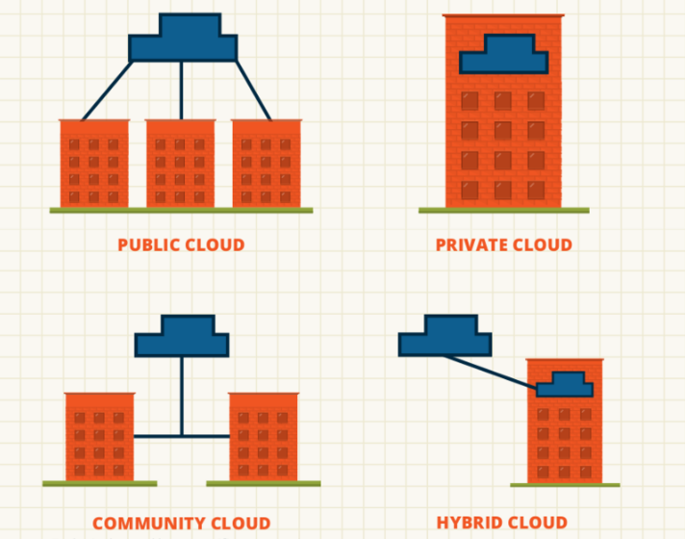
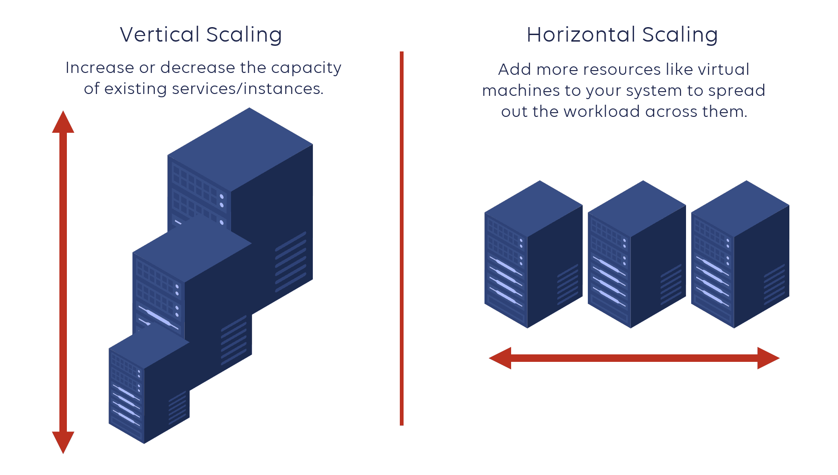
Introduction
Cloud Computing - Private Cloud Public Cloud Hybrid Cloud Community Cloud Cloud Concepts - Elasticity Scalability Vertical Scaling (Scaling Up) Horizontal Scaling (Scaling Out)

Slide 3
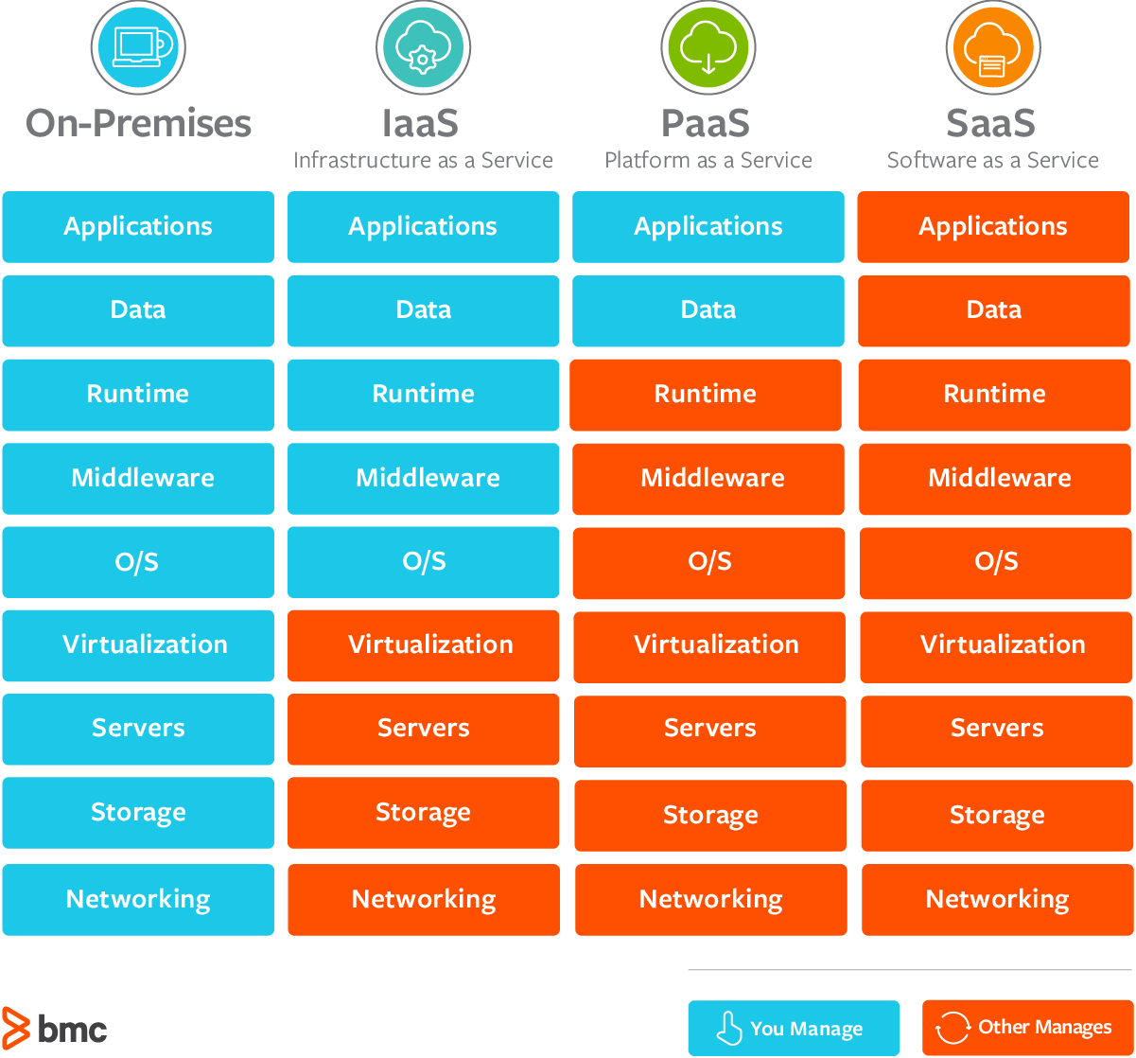
Models of Cloud Computing
▪ Network as a Service (NaaS) ▪ Infrastructure as a Service (IasS) ▪ Software as a Service (SaaS) ▪ Platform as a Service (PaaS)

Slide 4
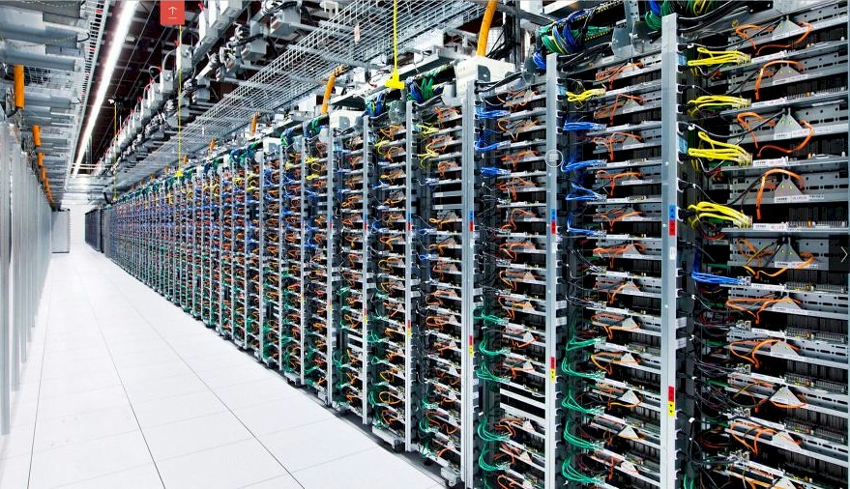
Datacenter Architecture
Facility – the usable space available for IT equipment
Optimize space and environmental control
Core components – equipment and software for IT operations and storage of data and applications.
Support infrastructure – equipment contributing to securely sustaining the highest availability possible

Slide 5
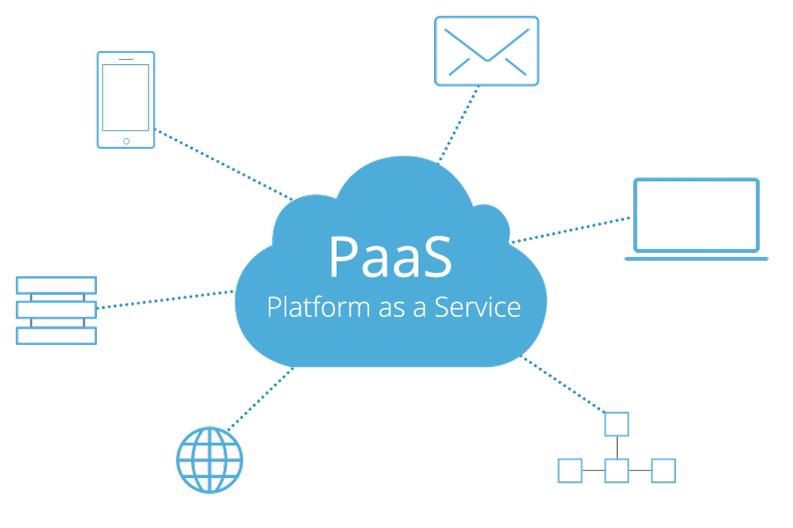
Our Plan
DHS would need a Platform as a Service
Why?
Topic states need for new software and services
PaaS checks boxes best

Slide 6

Benefits of Using PaaS
Easy to market
Low risk
Scalable
Easy to manage
Saves time and money

Slide 7

Challenge
The whole system being online makes everything accessible to hacks
A security breach would leak all of your content

Slide 8

Challenge cont.
You are forced to rely on the third party
They have the ability to see and control your content

Slide 9

Rebuttal
Encryption allows more privacy and more protection from hacks
You can employ security on your end to be private from the Cloud Service Provider, and be safe from attacks

Slide 10

Rebuttal cont
A reliable Cloud Service provider would not violate your privacy
A reputable name is more important than invading the privacy of one of their customers

Slide 11
Conclusion
DHS would need PAAS
PaaS supply much of the infrastructure and other IT services,
Allows users to access anywhere through a web browser
PaaS product can also enable development teams to collaborate and work together, regardless of their physical location

Slide 12
Thank You
Notes and Sources

